Slide 1
Seminar
Date：09.01.2024
Researcher (Students name) ：S. Hema Rohith(21043)
L. Chetan Harsha(21030)
Advisor name: Dr. Sita Devi Bharatula

Slide 2
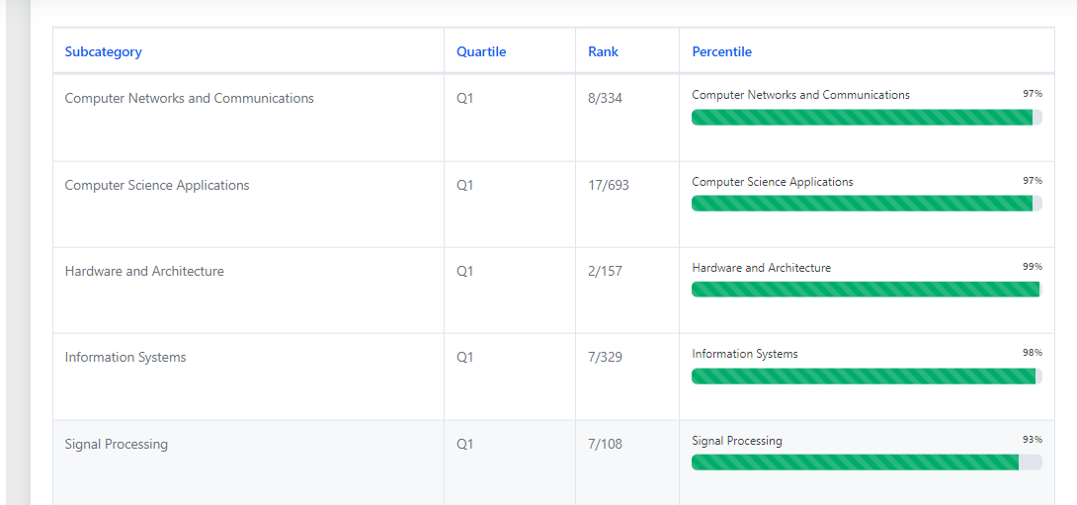

Slide 3
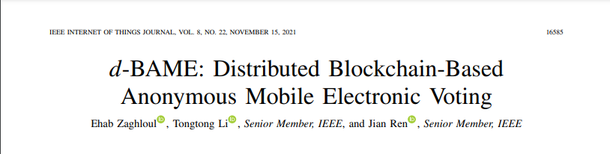
Abstract—Electronic voting (e-voting) presents a convenient and cost-effective alternative to current paper ballot-based voting. It provides many benefits such as increased voter turnout and accuracy in the decision-making process. While presenting many improvements, e-voting still faces serious security challenges that hinder its adoption, especially when designed to be run over mobile devices. In this article, we propose a novel remote e-voting model for large-scale elections by proposing the participation of two conflicting parties to ensure election integrity and accountability. Our scheme can be implemented in IoT devices such as smartphones, which we believe can significantly increase voter turnout of the election process. Our proposed work is secure and preserves voter privacy through secure multiparty computations performed by parties of differing allegiances. It also leverages a blockchain running smart contracts as a publicly accessible and tamper-resistant bulletin board to permanently store votes and prevent double voting.

Slide 4
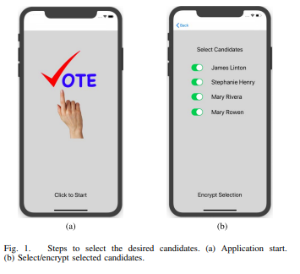
PROPOSED SCHEME

Slide 5
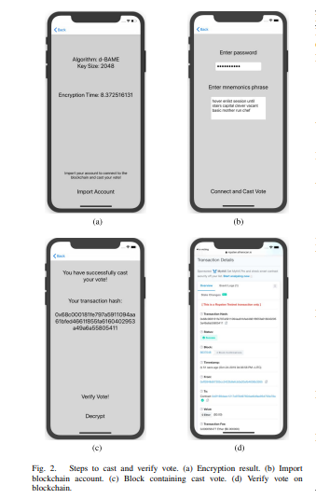

Slide 6
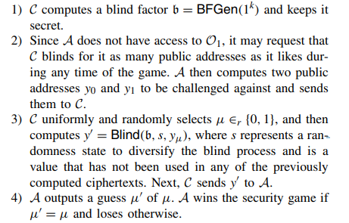
Voter Anonymity

Slide 7
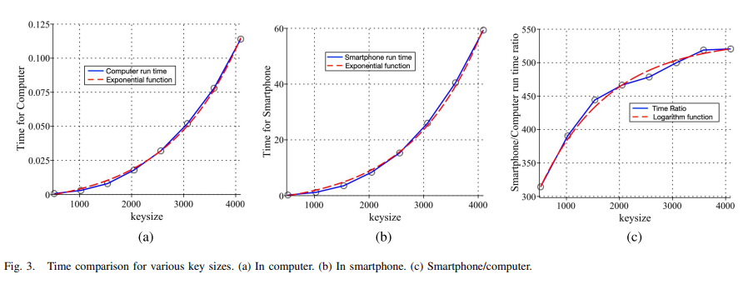
Result and Graphs

Slide 8
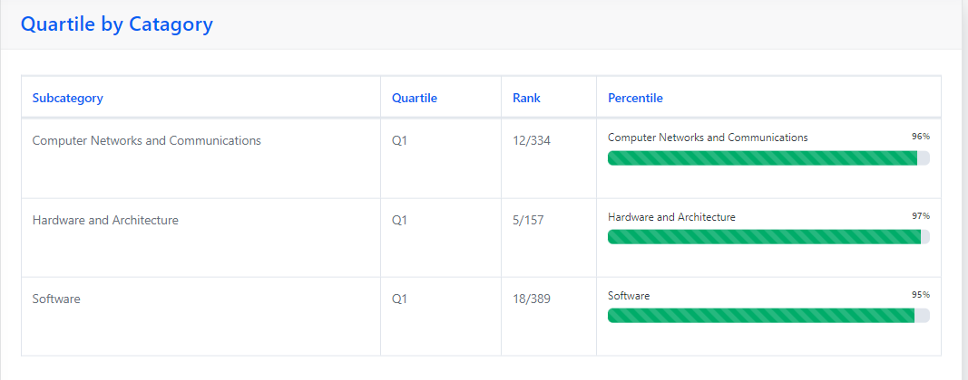

Slide 9
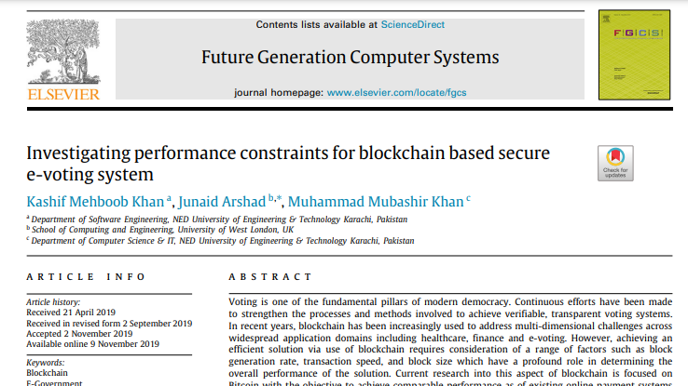

Slide 10
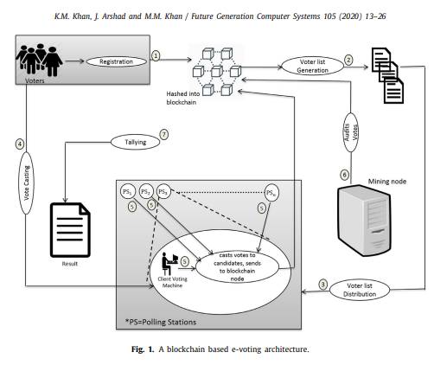
Blockchain Architecture

Slide 11
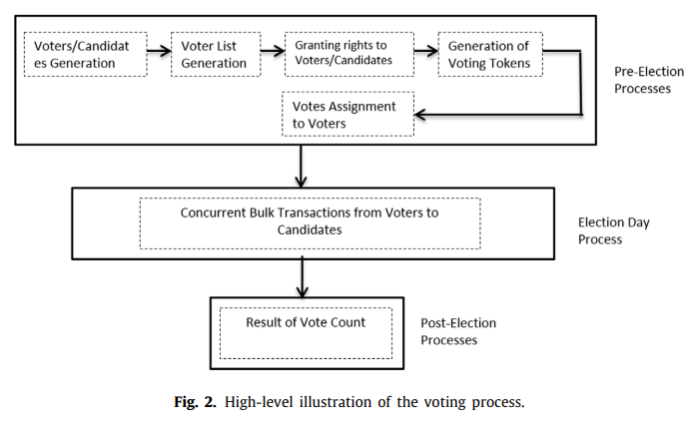

Slide 12
A blockchain based e-voting system
Decentralization
Voter Identity Verification
Voting Transactions
Immutable Record
Transparency and Accessibility
Security Measures

Slide 13
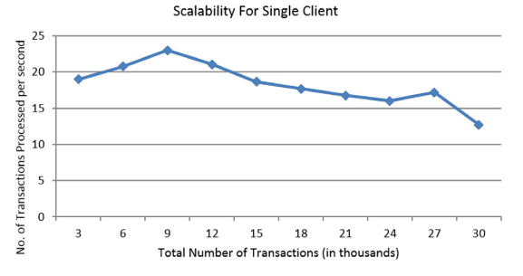

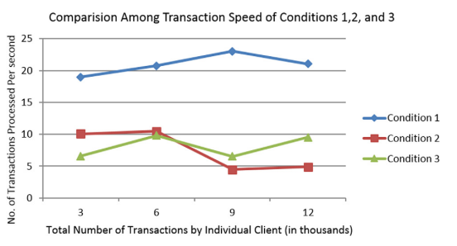
Graphs

Slide 14
THANK YOU

